Slide 1
Signal Processing Lab

Slide 2
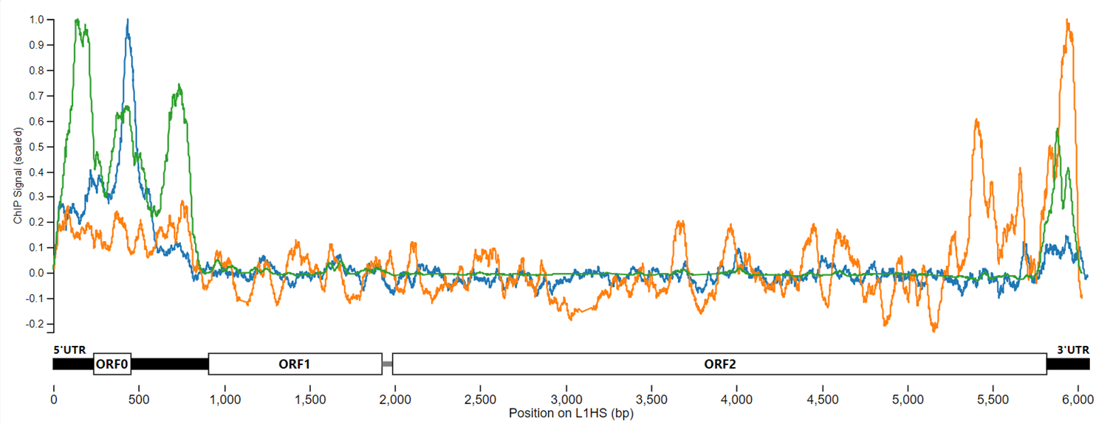
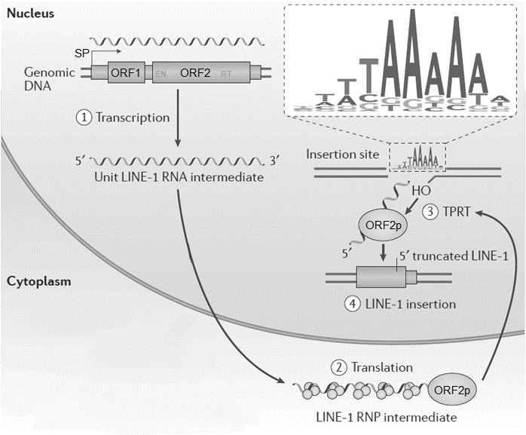
Transcription factor binding to LINE-1
MYC
CTCF
Sun X et al., Transcription factor profiling reveals molecular choreography and key regulators of human retrotransposon expression, PNAS 2018.

Slide 3
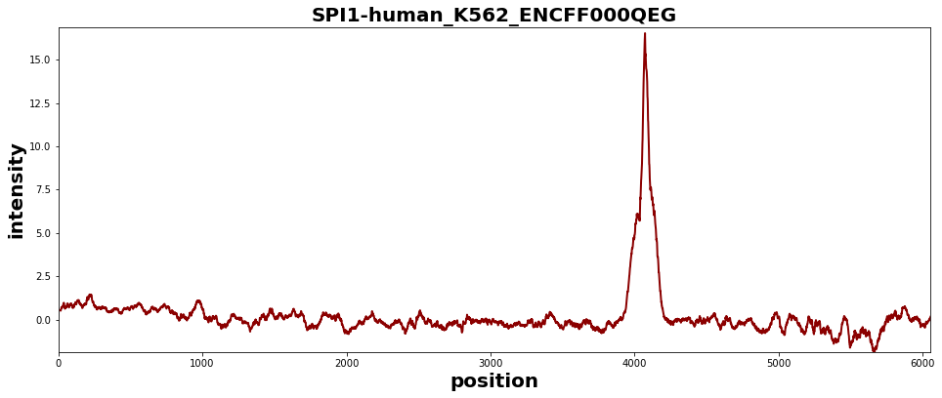
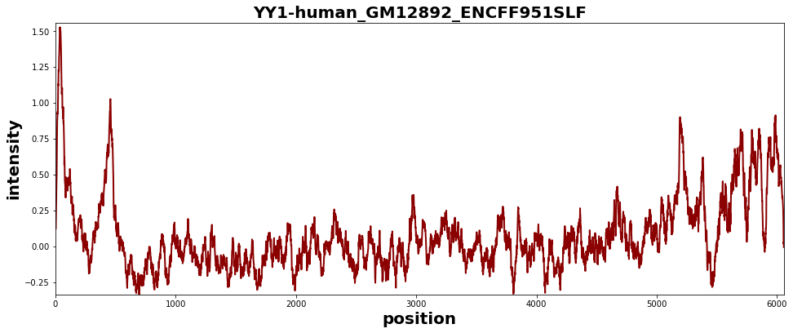
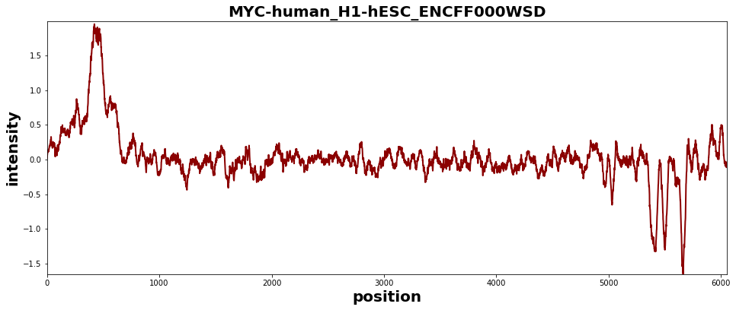
Peak Finding Examples
Example 1
Example 2
Example 3

Slide 4
Peak Finding
Step 1: Find an RMSD threshold to separate peaks from noise
Step 2: Find maxima in derivative of smoothed data to find peak apex
Step 3: Find minima in derivative of smoothed data to find peak start and end
Step 4: Characterize peak (location, height, area etc.)

Slide 5
Peak Finding Example 1

Slide 6
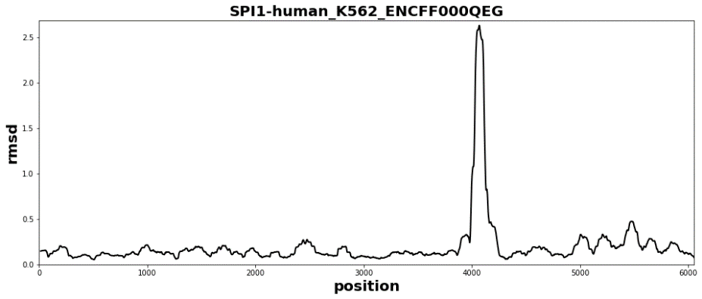
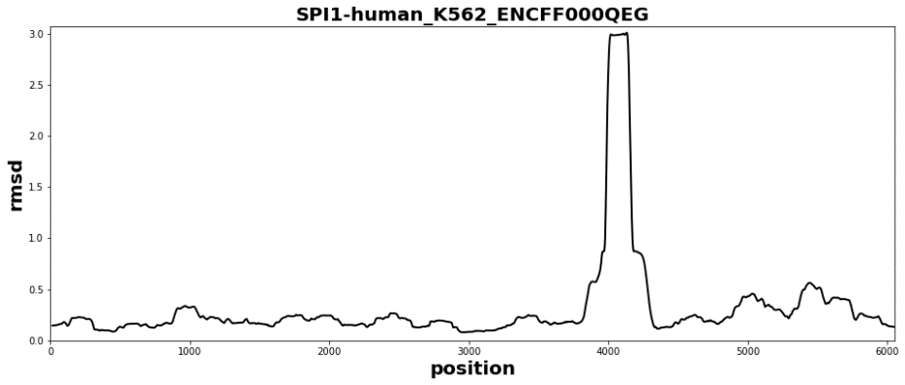
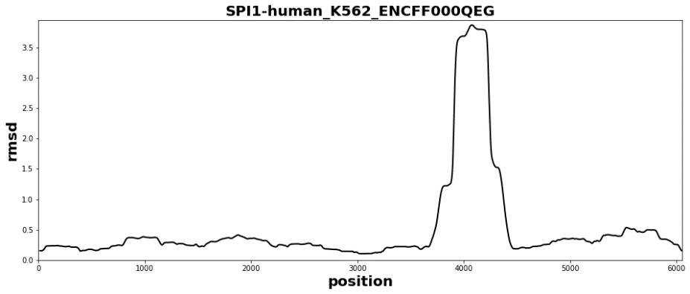
Peak Finding Example 1
Original Data
RMSD
Window Size
40
80
160
RMSD 40
RMSD 80
RMSD 160

Slide 7
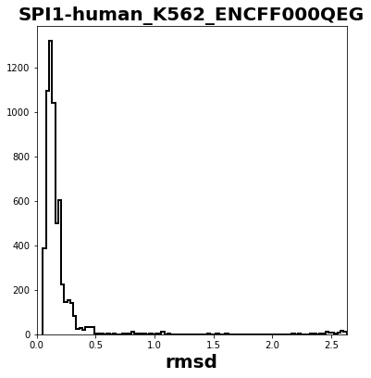
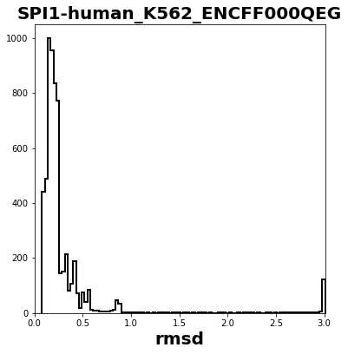
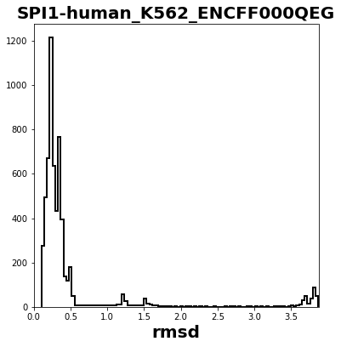
Peak Finding Example 1
RMSD
Window
Size
40
80
160
Original Data

Slide 8
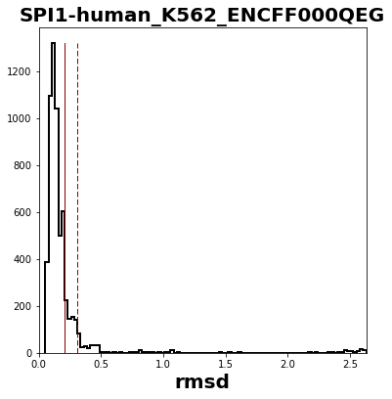
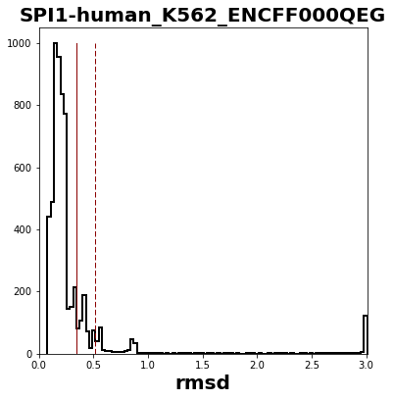
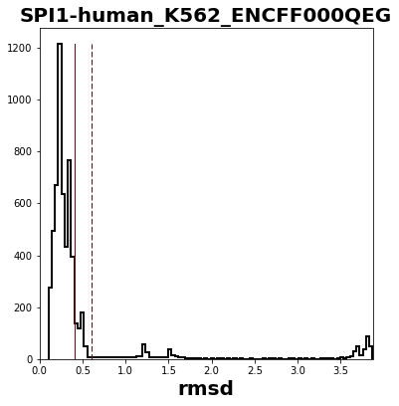
Peak Finding Example 1
RMSD
Window
Size
40
80
160

Slide 9
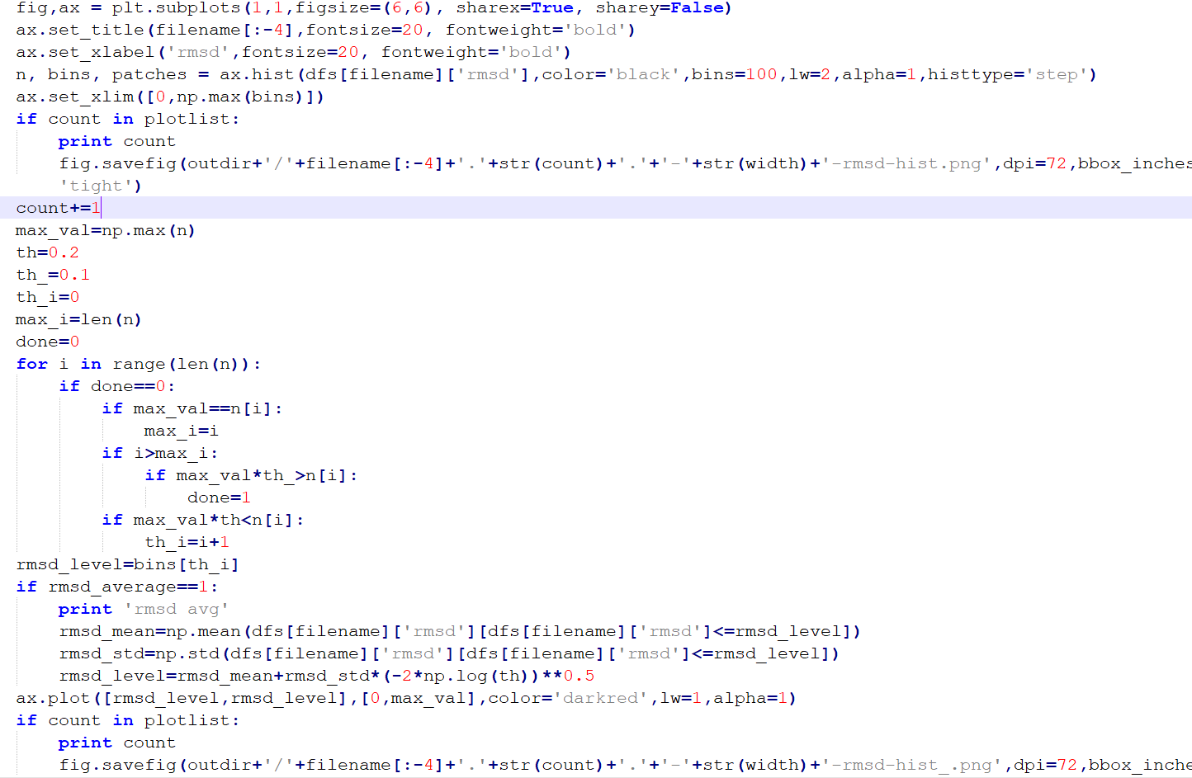
Step 1: Find an RMSD threshold to separate peaks from noise

Slide 10
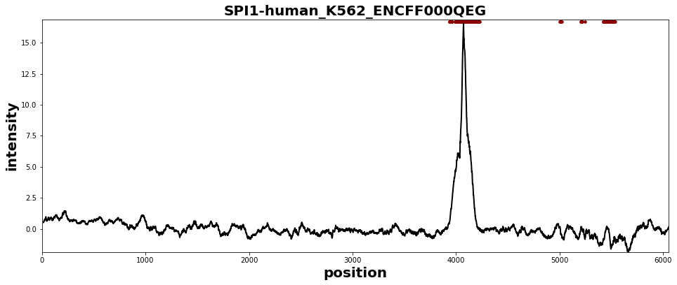
Peak Finding Example 1
Original Data
RMSD
Window Size
40
80
160
Original Data
Original Data
Original Data

Slide 11
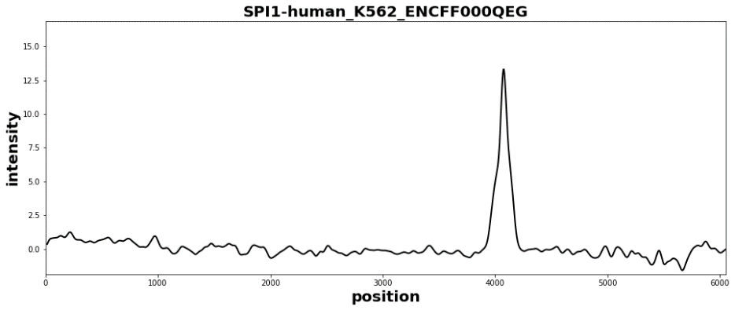
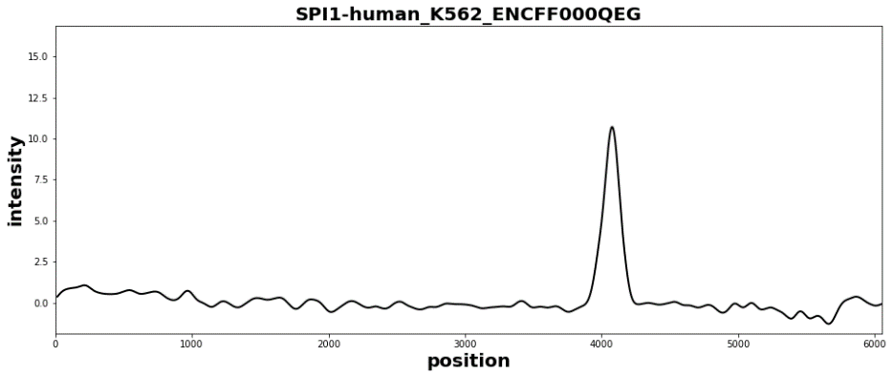
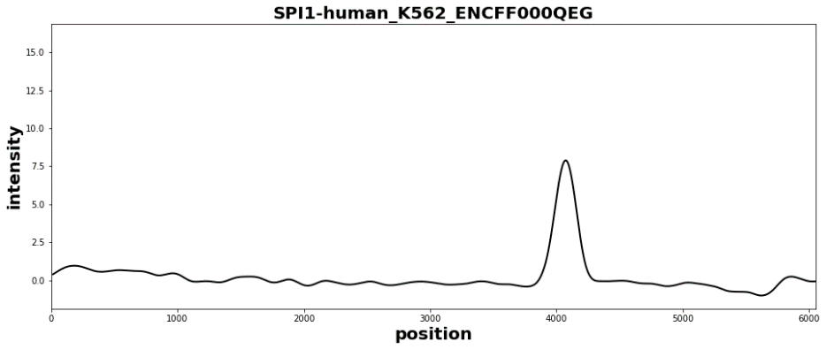
Peak Finding Example 1
Original Data
Smoothing
Window Size
40
80
160
Smoothing 40
Smoothing 80
Smoothing 160

Slide 12
Smoothing the data
Smoothing:
dfs[filename]['int-smooth'] = np.convolve(w2/w2.sum(),dfs[filename]['intensity'],'same')

Slide 13
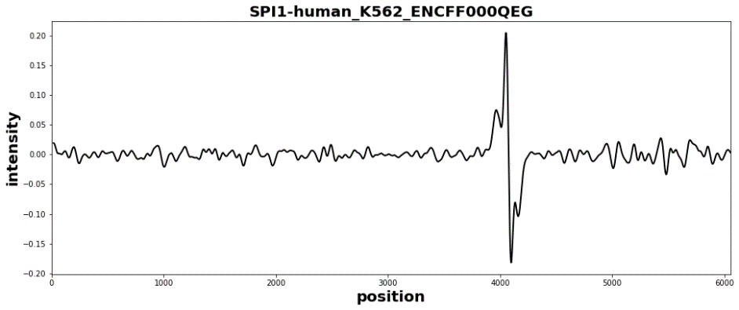
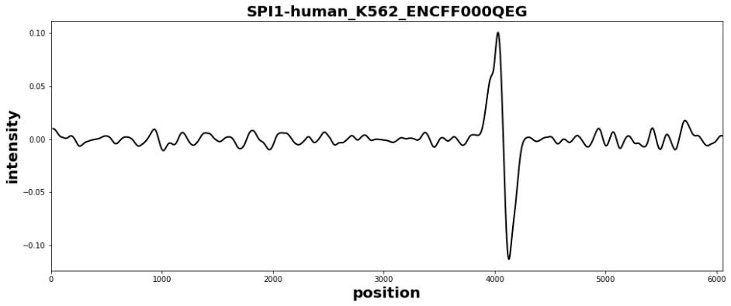
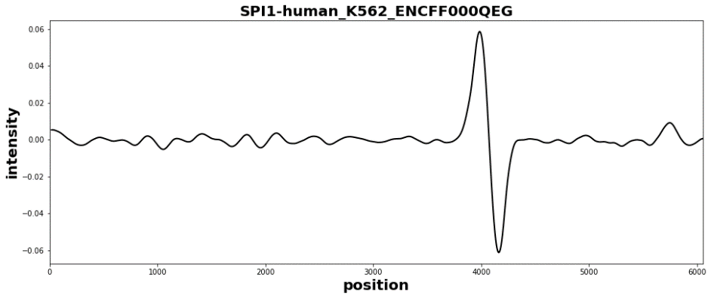
Peak Finding Example 1
Original Data
Smoothing
Window Size
40
80
160
Derivative of smoothing 40
Derivative of smoothing 80
Derivative of smoothing 160

Slide 14
Derivative of smoothed data
Derivative:
dfs[filename]['int-diff']=dfs[filename]['int-smooth'].diff()

Slide 15
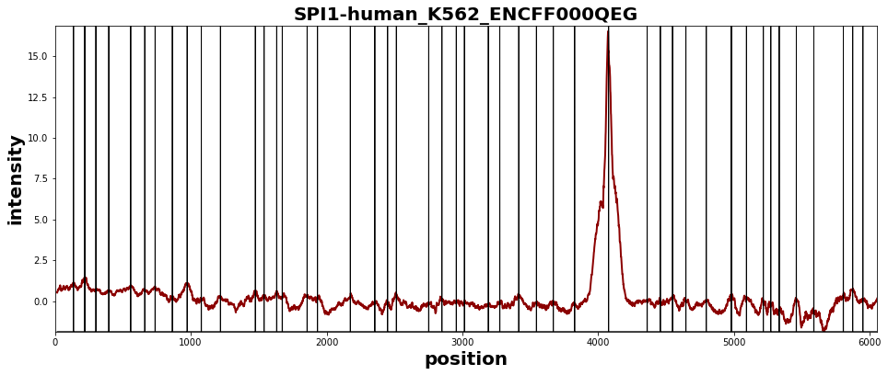
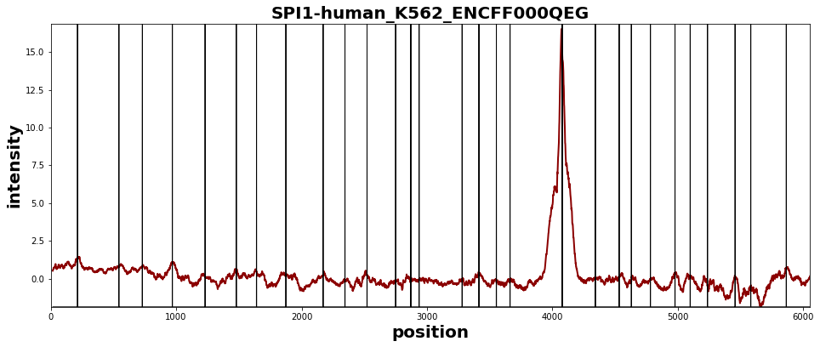
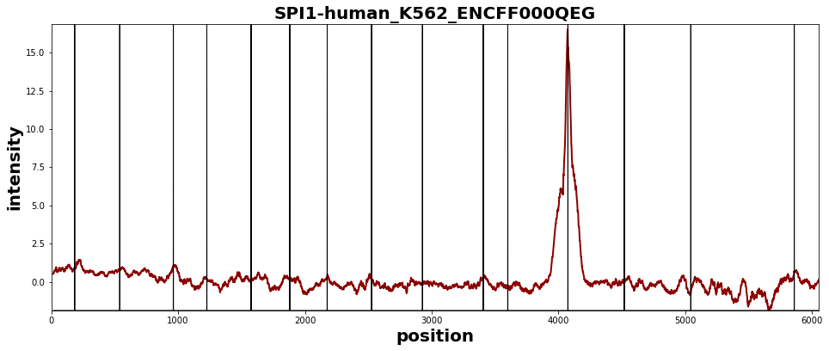
Peak Finding Example 1
Original Data
Smoothing
Window Size
40
80
160
Original Data, maxima
Original Data, maxima
Original Data, maxima

Slide 16
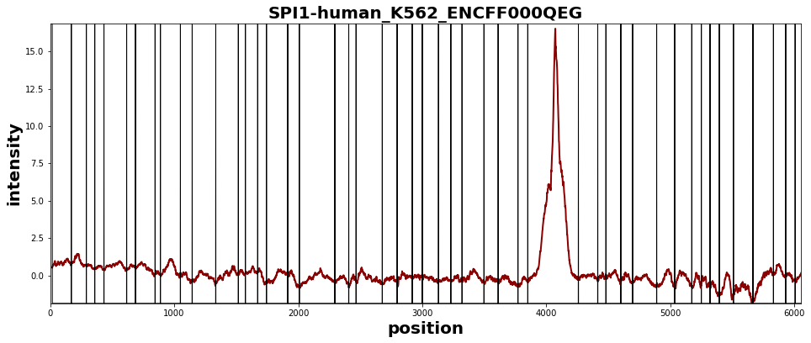
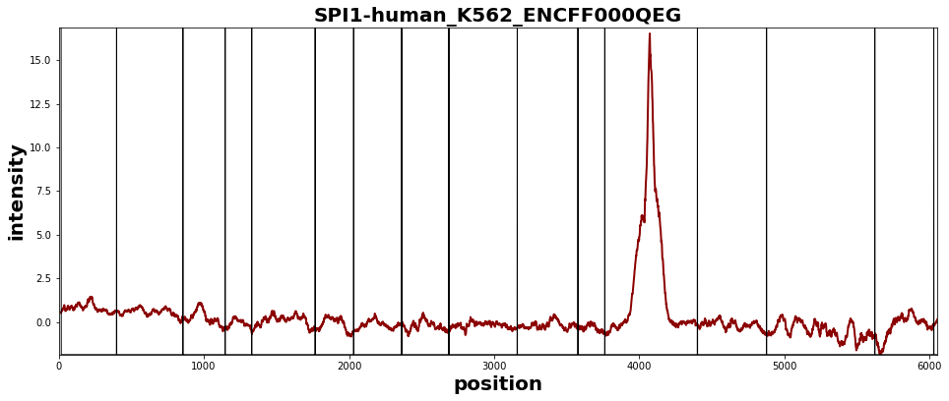
Peak Finding Example 1
Original Data
Smoothing
Window Size
40
80
160
Original Data, minima
Original Data, minima
Original Data, minima

Slide 17
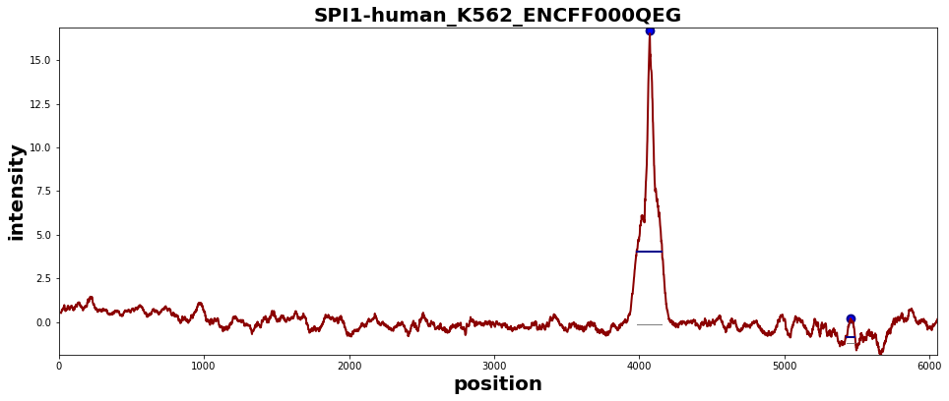
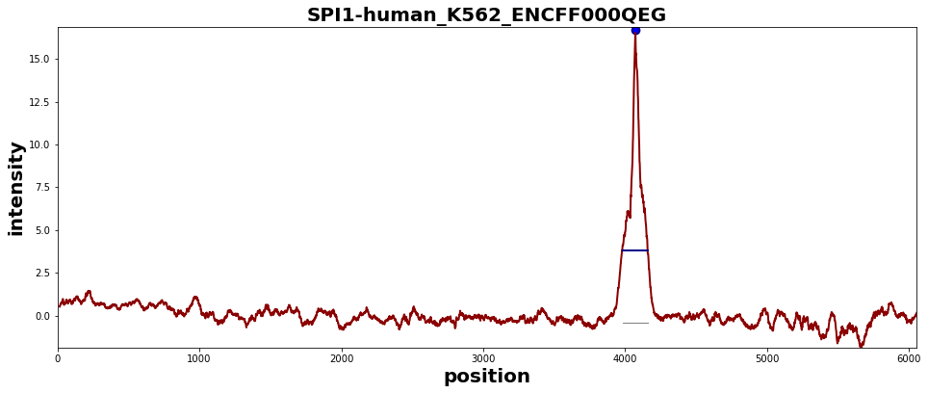
Peak Finding Example 1
Original Data
Smoothing
Window Size
40
80
160
Original Data, peaks
Original Data, peaks
Original Data, peaks

Slide 18
Peak Finding Example 2

Slide 19
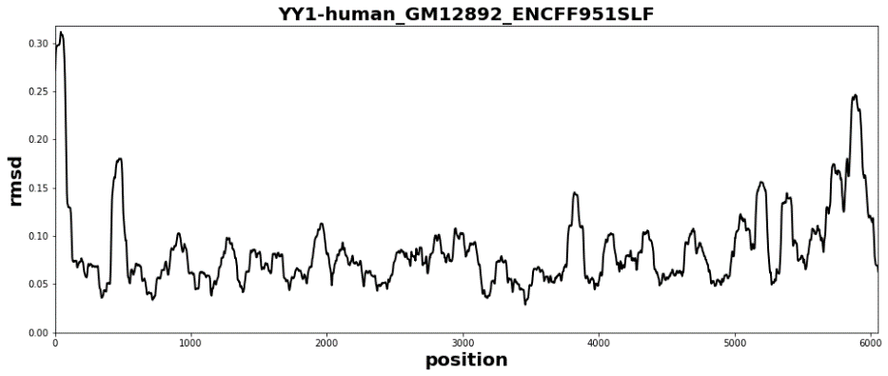
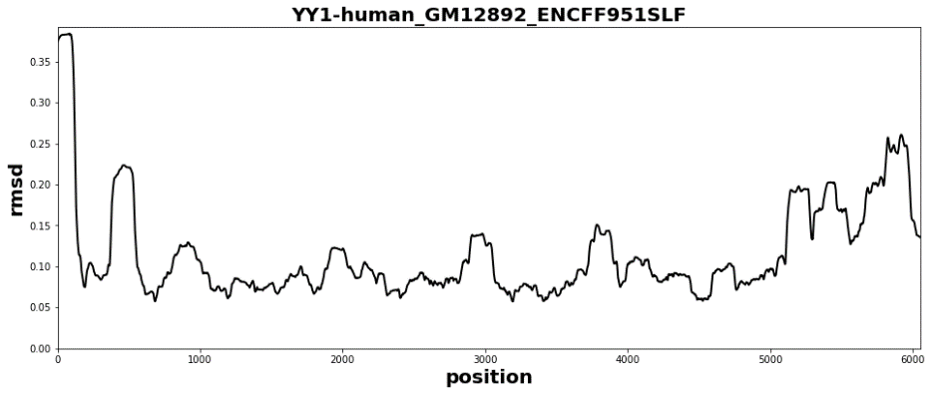
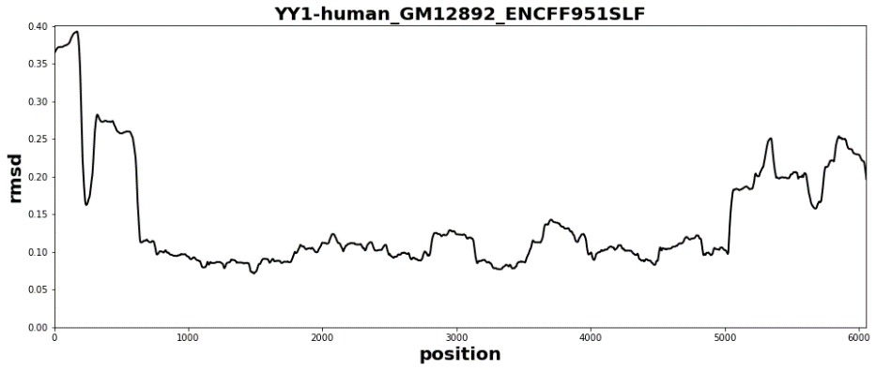
Peak Finding Example 2
Original Data
RMSD
Window Size
40
80
160
RMSD 40
RMSD 80
RMSD 160

Slide 20
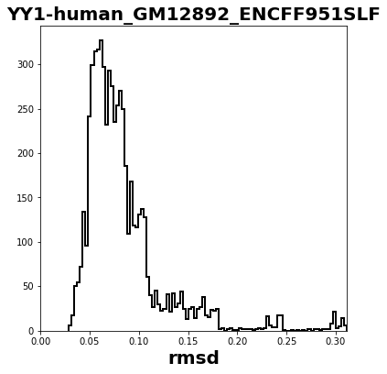
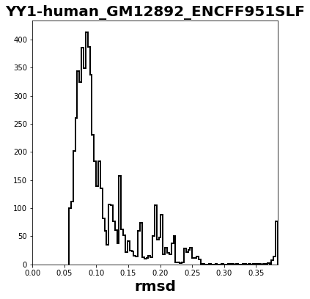
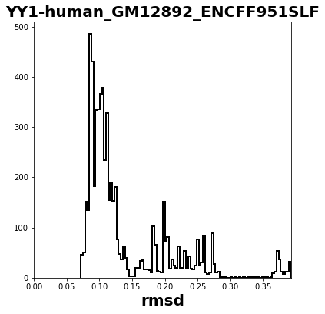
Peak Finding Example 2
RMSD
Window
Size
40
80
160
Original Data

Slide 21
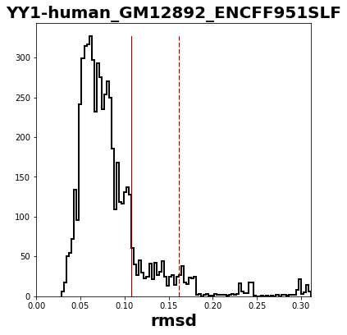
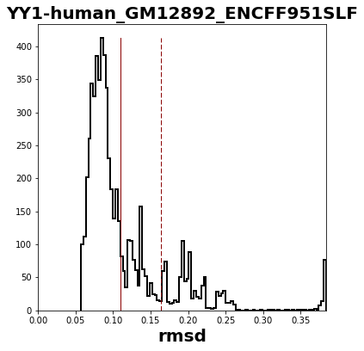
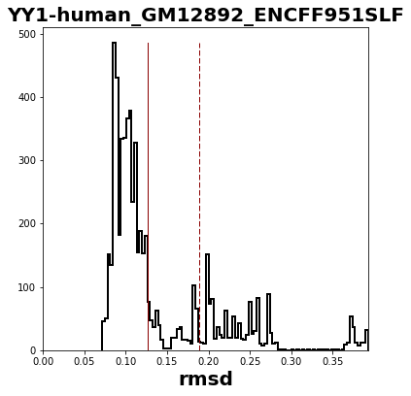
Peak Finding Example 2
RMSD
Window
Size
40
80
160
Original Data

Slide 22
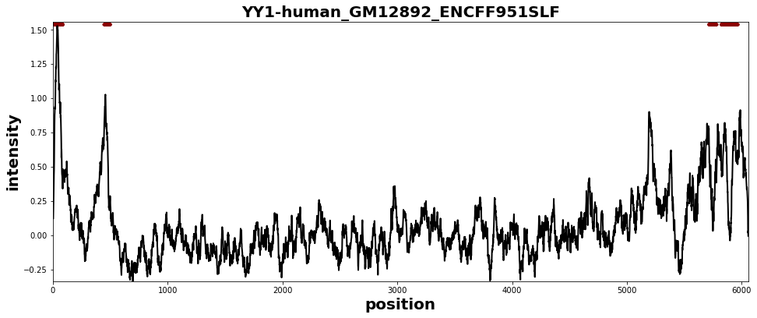
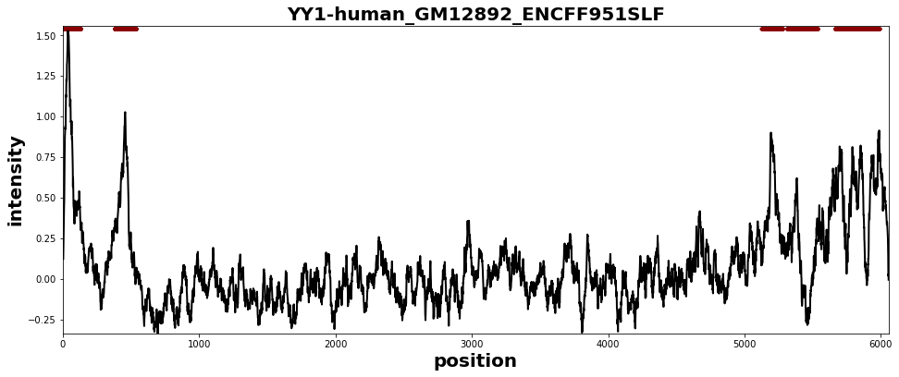
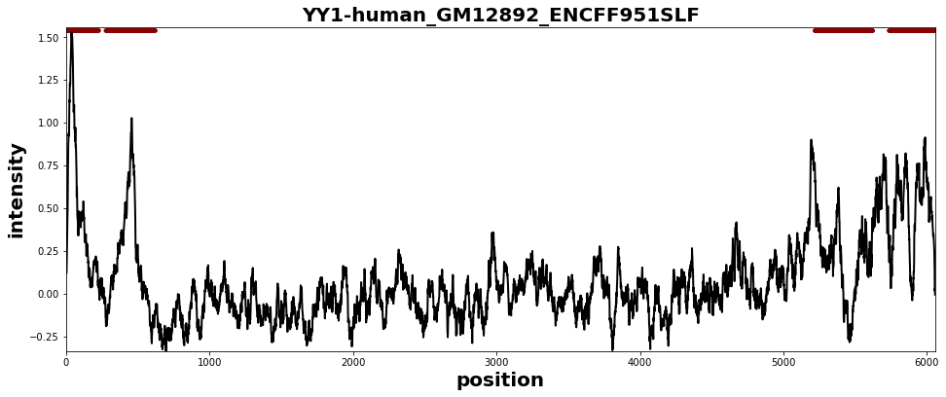
Peak Finding Example 2
Original Data
RMSD
Window Size
40
80
160
Original Data
Original Data
Original Data

Slide 23
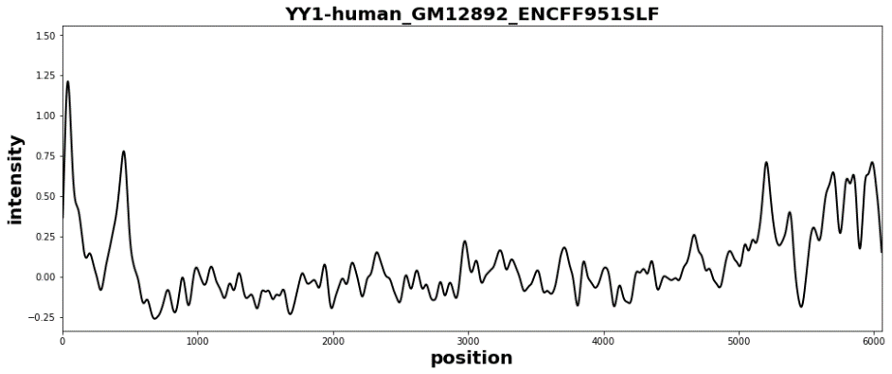
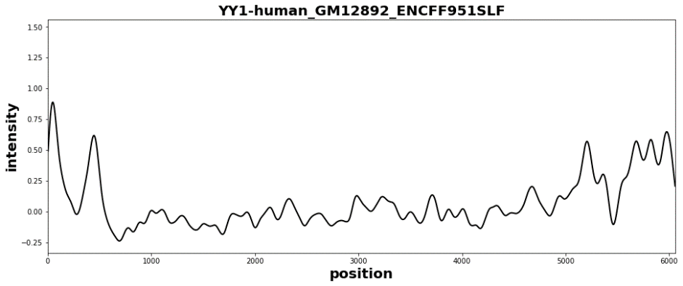
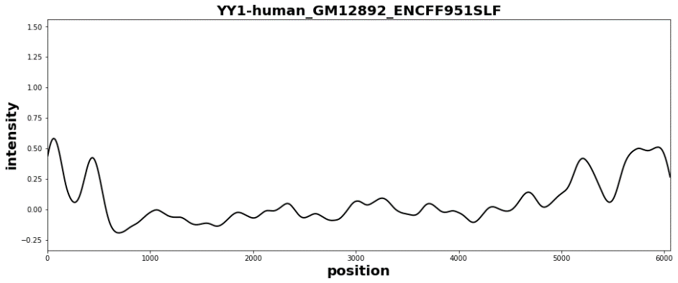
Peak Finding Example 2
Original Data
Smoothing
Window Size
40
80
160
Smoothing 40
Smoothing 80
Smoothing 160

Slide 24
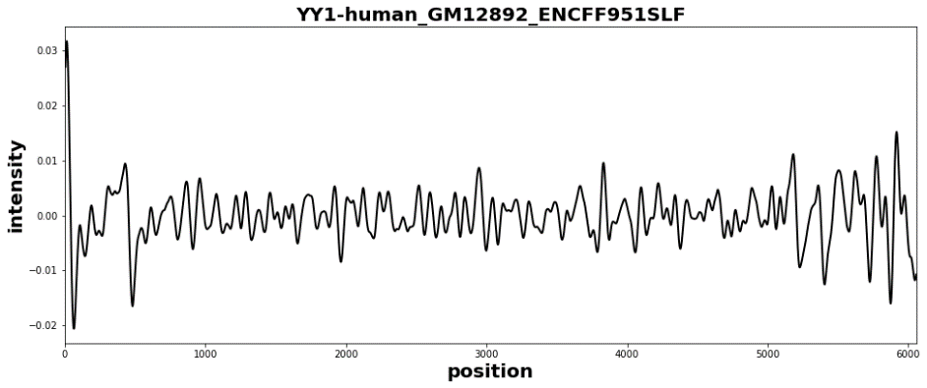
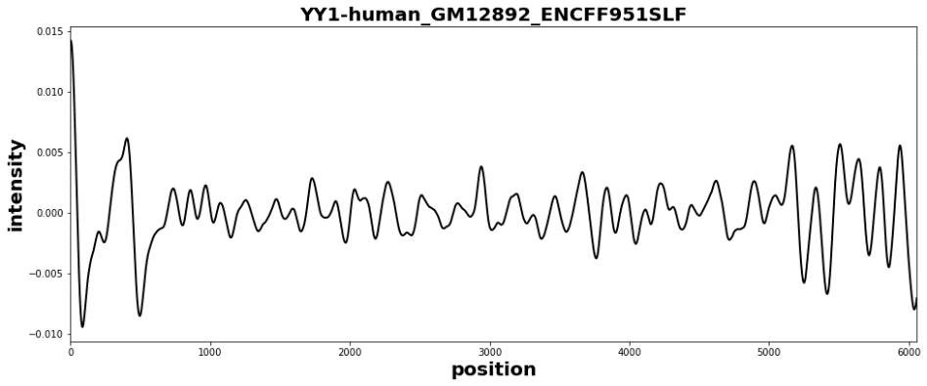
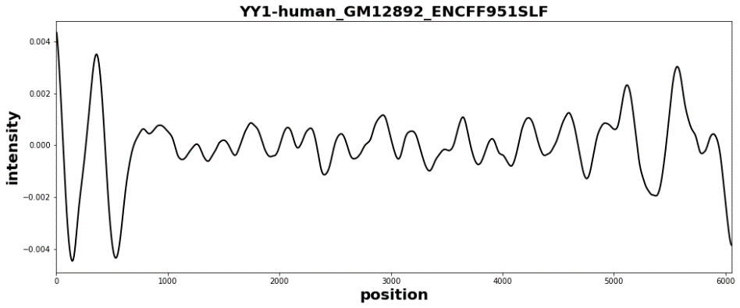
Peak Finding Example 2
Original Data
Smoothing
Window Size
40
80
160
Derivative of smoothing 40
Derivative of smoothing 80
Derivative of smoothing 160

Slide 25
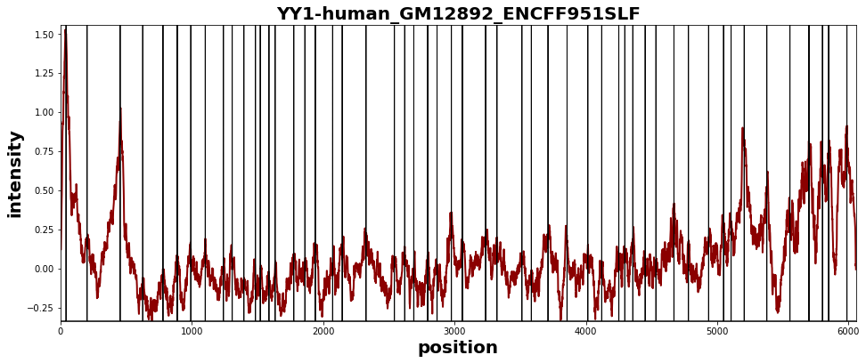
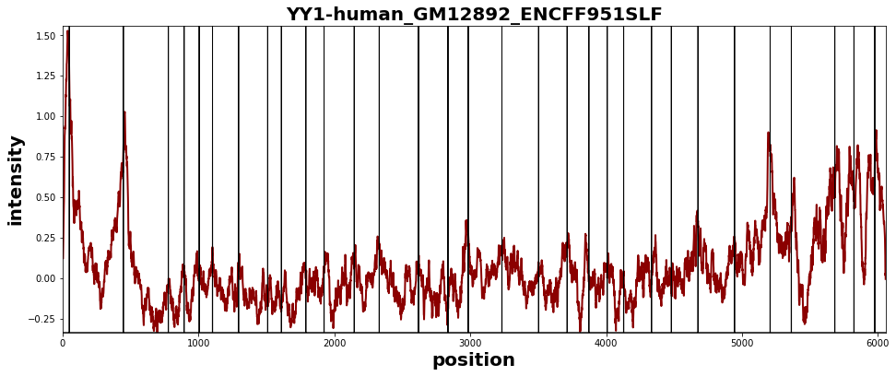
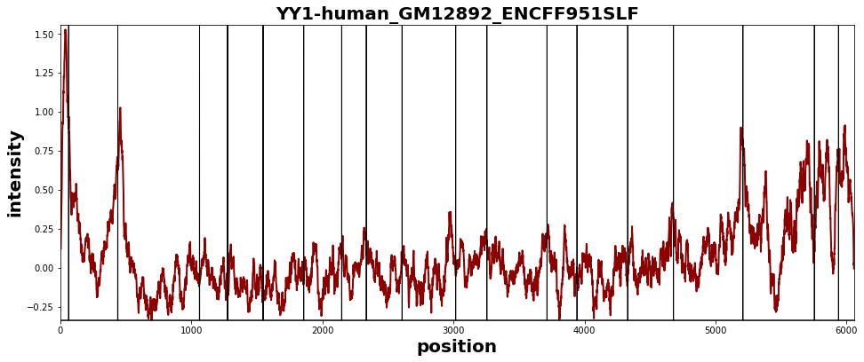
Peak Finding Example 2
Original Data
Smoothing
Window Size
40
80
160
Original Data, maxima
Original Data, maxima
Original Data, maxima

Slide 26
Peak Finding Example 2
Original Data
Smoothing
Window Size
40
80
160
Original Data, minima
Original Data, minima
Original Data, minima

Slide 27
Peak Finding Example 2
Original Data
Smoothing
Window Size
40
80
160
Original Data, peaks
Original Data, peaks
Original Data, peaks

Slide 28
Peak Finding Example 3

Slide 29
Peak Finding Example 3
Original Data
RMSD
Window Size
40
80
160
RMSD 40
RMSD 80
RMSD 160

Slide 30
Peak Finding Example 3
RMSD
Window
Size
40
80
160
Original Data

Slide 31
Peak Finding Example 3
RMSD
Window
Size
40
80
160
Original Data

Slide 32
Peak Finding Example 3
RMSD
Window Size
40
80
160
Original Data
Original Data
Original Data
Original Data

Slide 33
Peak Finding Example 3
Smoothing
Window Size
40
80
160
Original Data
Smoothing 40
Smoothing 80
Smoothing 160

Slide 34
Peak Finding Example 3
Smoothing
Window Size
40
80
160
Original Data
Derivative of smoothing 40
Derivative of smoothing 80
Derivative of smoothing 160

Slide 35
Peak Finding Example 3
Smoothing
Window Size
40
80
160
Original Data
Original Data, maxima
Original Data, maxima
Original Data, maxima

Slide 36
Peak Finding Example 3
Smoothing
Window Size
40
80
160
Original Data
Original Data, minima
Original Data, minima
Original Data, minima

Slide 37
Peak Finding Example 3
Smoothing
Window Size
40
80
160
Original Data
Original Data, peaks
Original Data, peaks
Original Data, peaks

Slide 38
Peak Finding
Step 1: Find an RMSD threshold to separate peaks from noise
Step 2: Find maxima in derivative of smoothed data to find peak apex
Step 3: Find minima in derivative of smoothed data to find peak start and end
Step 4: Select intensity threshold to remove peaks above the RMSD threshold because of large valleys
Step 5: Characterize peak (location, height, area etc.)

Slide 39
Peak Finding Example 3
Smoothing
Window Size
40
80
160
Original Data
Original Data, peaks
Original Data, peaks
Original Data, peaks

